Slide 1
Session: Install and Configure Watson Assistant and Watson Discovery on Cloud Pak for Data
Session ID = J0558, Check-in ID = 0355
Jennifer Wales
Offering Manager, Data and AI Expert Labs
jennifer_wales@us.ibm.com
Brandon Swink
Analytics and AI Architect, North America
swink@us.ibm.com
http://ibm.biz/faststartinstallwatson

Slide 2





You Are Here: how this session fits in the AI Ladder story
Install and Configure Watson Assistant and Watson Discovery on Cloud Pak for Data
Interact with Pre-built AI Services
Watson Application Services
The Ladder to AI
Infuse
Build
Deploy
Catalog
Manage
Analyze
Watson
Studio
Watson Machine Learning
Watson
Knowledge
Catalog
Watson OpenScale
Organize
Collect
Unlock the value of your data and accelerate your journey to AI
AI Open Source Frameworks
Unify on a Multicloud Data Platform
IBM Cloud Pak for Data
A one of a kind, pre-integrated set of data and AI services
delivered within an open and extensive cloud native platform
Cloud-native container platform and operational services
AWS
MS Azure
Google Cloud
2
IBM Cloud
Edge
Private
Hyperconverged
Private Cloud System

Slide 3
Legal Disclaimer
{Remove after Editing: Sections / text in red need to be customized for each presentation and then removed from the final draft.}
© IBM Corporation 2020. All Rights Reserved.
The information contained in this publication is provided for informational purposes only. While efforts were made to verify the completeness and accuracy of the information contained in this publication, it is provided AS IS without warranty of any kind, express or implied. In addition, this information is based on IBM’s current product plans and strategy, which are subject to change by IBM without notice. IBM shall not be responsible for any damages arising out of the use of, or otherwise related to, this publication or any other materials. Nothing contained in this publication is intended to, nor shall have the effect of, creating any warranties or representations from IBM or its suppliers or licensors, or altering the terms and conditions of the applicable license agreement governing the use of IBM software.
References in this presentation to IBM products, programs, or services do not imply that they will be available in all countries in which IBM operates. Product release dates and/or capabilities referenced in this presentation may change at any time at IBM’s sole discretion based on market opportunities or other factors, and are not intended to be a commitment to future product or feature availability in any way. Nothing contained in these materials is intended to, nor shall have the effect of, stating or implying that any activities undertaken by you will result in any specific sales, revenue growth or other results.
If the text contains performance statistics or references to benchmarks, insert the following language; otherwise delete: Performance is based on measurements and projections using standard IBM benchmarks in a controlled environment. The actual throughput or performance that any user will experience will vary depending upon many factors, including considerations such as the amount of multiprogramming in the user's job stream, the I/O configuration, the storage configuration, and the workload processed. Therefore, no assurance can be given that an individual user will achieve results similar to those stated here.
If the text includes any customer examples, please confirm we have prior written approval from such customer and insert the following language; otherwise delete: All customer examples described are presented as illustrations of how those customers have used IBM products and the results they may have achieved. Actual environmental costs and performance characteristics may vary by customer.
Review text for proper trademark attribution of IBM products. At first use, each product name must be the full name and include appropriate trademark symbols. Subsequent references can drop “IBM” but should include the proper branding (e.g., IBM Bluemix or WebSphere Application Server). Please refer to http://www.ibm.com/legal/copytrade.shtml for guidance on which trademarks require the ® or ™ symbol. Do not use abbreviations for IBM product names in your presentation. All product names must be used as adjectives rather than nouns. Please list all of the trademarks that you use in your presentation
If the text/graphics include screenshots, no actual IBM employee names may be used (even your own), if your screenshots include fictitious company names (e.g., Renovations, Zeta Bank, Acme) please update and insert the following; otherwise delete: All references to [insert fictitious company name] refer to a fictitious company and are used for illustration purposes only.

Slide 4
Session Agenda
Introduction to Lab
Expected Outcome
Overview of the process
Requirements for Installation
Self-paced: Follow steps to install and configure Watson Assistant or Watson Discovery on the OCP cluster.
Student feedback on the Lab
Additional Resources

Slide 5
Overview of end to end process
Provision VM
Prepare Nodes
OpenShift installation
Storage set up
CPD install
Add-on install
Provision VMs according to the deployment architecture and detailed requirement for each type of nodes
Prepare Nodes for the OpenShift installation.
IPV4Forwarding
SELINUX enforce
Clock Sync
Docker Disk mount
Enable and start Network Manager
Register machines with RedHat subscription/Pool-Id
Unsubscribe non required RPMs
Subscribe Only OCP packages
Install Openshift 3.11 on the provisioned environment
Install with Inventory file and ansible scripts
Setup Users & Permissions
Important: CRI-O required for Portworx
Set up Storage required for Cloud Pak and Watson.
NFS or Portworx can be used for CP4D
Portworx required for Watson Install
Deploy CPD Control Plane to the OCP cluster
Download Installer and Key from PPA
Update the “repo.yaml”
Download assembly
Transfer the Image
Install the Assembly
Deploy Watson Extension(s)
Download PPA
Run pre-install steps
Deploy.sh / helm install
Provision Instance

Slide 6
Watson Requirements
Platform Support
Bare Metal, VM, AWS, Azure
CP4D 2.5 on OpenShift 3.11
CP4D System 1.0.4 (with Portworx)
CP4D 2.1.0.x on ICP or OpenShift 3.11
x86 platform / Intel architecture nodes only
CPUs must have 2.4 GHz or higher clock speed
CPUs must support Linux SSE 4.2
CRI-O Container Runtime (Required for Portworx)
CRI-O PID LIMIT=8192
Portworx Installed and Configured & Running on all nodes
Managed OpenShift in IBM Cloud not yet certified for Watson
Watson Assistant
CPUs must support the AVX2 instruction set
Watson Discovery
CPUs must support the AVX2 instruction set
SELINUX set to Enforcing
vm.max_map_count = 262144

Slide 7
What you need to know before installing
Package(s) to be installed, Option(s) to be installed
Cluster name (load balancer or infra node)
Cluster IP address
Master IP address
Installation type - ha mode or dev mode
Storage class
Language(s)
# of Instances / # of Helm Installs
Release Name
Installing from inside or outside of OpenShift Cluster
Notes:
What package – wd license includes wds and wks – 2 separate packages. Wd has optional license for content intelligence and separate deployment for the language pack.
Where you work is important – if outside of the cluster (ie bastion host), that host will need to be setup with docker, helm, the oc cli, etc. When logging into your cluster, you will have to specify different syntax for oc login and docker login.

Slide 8
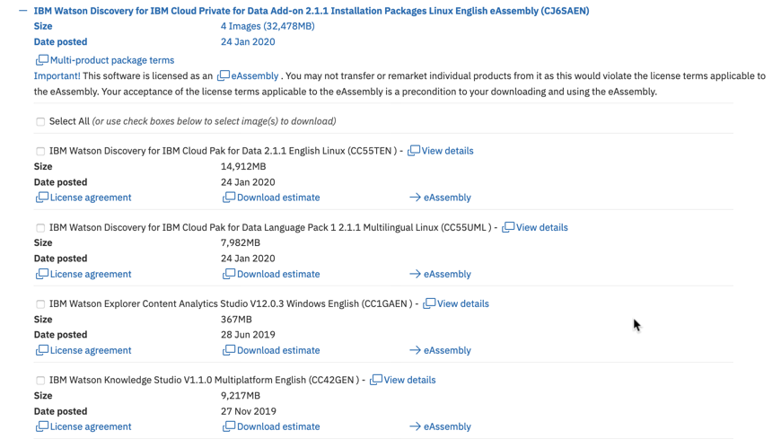
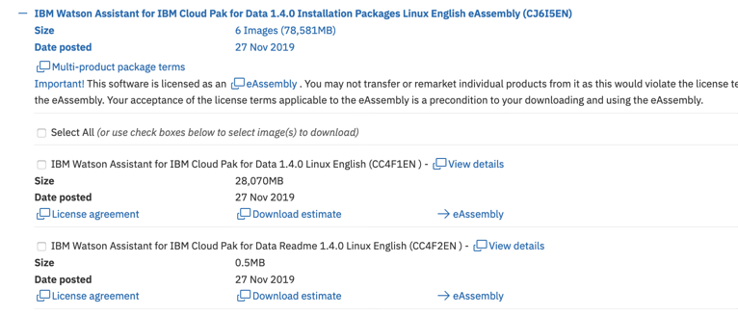
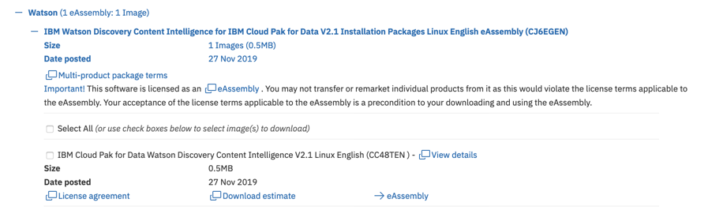
Watson Packages
ibm.biz/cp4drelease

Slide 9
Overview of Watson Installation
Watson Assistant
Watson Discovery
Download & Prepare Cheatsheet for Install
Verify Prereqs are met
Download Watson Archive from Passport Advantage (1-2 hours)*
Extract Archive and Chart *
Load Watson Images to the Docker Registry (30 -60 minutes) *
Create Portworx class
Label namespace
Create Override yaml
Install Helm
Run Helm install (45 minutes)
Provision Watson instance
Verify Deployment (Tooling, Test Chart, API Tests)
Collect Documentation
Download & Prepare Cheatsheet for Install
Verify Prereqs are met
Download Watson Archive(s) from Passport Advantage (1-2 hours)*
Extract Archive and Chart (20 mins)*
Label namespace
Create Override yaml (optional)
Run Deploy.sh
Creates Security Policies (SCC & PSP)
Adds all namespace users to SCC
Creates Cluster Role Bindings
Loads the Watson Images to the Docker Registry*
Launches Helm install
Provision Watson instance
Verify Deployment (Tooling, Test Chart, API Tests)
Collect Documentation
Install language packs (if languages other than English needed)
*Completed for lab clusters
Notes:
Override file necessary for WA and optional for WDS
WDS – override for Prod deploy or content intelligence deploy

Slide 10
Compute
Watson Assistant
Dev: 7 cores / 75G RAM / 3 Worker Nodes
HA: 10 Cores / 150G RAM / 5 Worker Nodes
Storage: Portworx
(1TB of RAW Disk on Workers 1,2,3)
Watson Discovery
Dev: 20 cores / 92G RAM / 3 Worker Nodes
HA: 40 Cores / 124G RAM / 4 Worker Nodes
Storage: Portworx
(1TB of RAW Disk on Workers 1,2,3)
+ CP4D Control Plane - 6 cores / 7G RAM
+ Portworx – 4 cores / 4G Ram
WA (Development) – 3 workers @ 16 cores / 64G RAM
WD (Development) – 3 workers @ 16 cores / 64G RAM

Slide 11
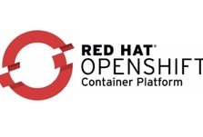
Provisioned Lab Environment
Load balancer
Lab Environment
Node | Quantity | CPU (VPC) | Memory (GB) | Disk storage(GB)
Master /Infra Node | 1 | 16 | 64 | /Root 100G /Docker: 200G
NFS / Infra Node | 1 | 8 | 8 | 660GB
Application Nodes | 3 | 16 | 64 | Root 100G /Docker: 200G Raw Disk 750G (Portworx)
Master/Infra Nodes
Application Nodes
(Workers)
Master Nodes
Infra Nodes
Worker1
Worker3
Worker1
Worker2
Worker3
Master Nodes
Master Nodes
Worker2
Master Nodes
Master Nodes
Docker and
Local
Local-storage
ETCD
Storage
Registry
Storage
Docker and
Local
Local-storage
App Storage
Portworx Storage
Login: root
Password: IBMDem0s! (zero)
NFS Storage

Slide 12
Accessing your Cluster
 |  | Credentials
SSH to Master | services-uscentral.skytap.com –p {sshport} | Username=root Password=IBMDem0s! (zero)
Skytap Cloud Pak Admin URL | https://services-uscentral.skytap.com:{adminport}/zen/#/gettingStarted | Username=admin Password=password
SFTP | services-uscentral.skytap.com –p {sshport} | Username=root Password=IBMDem0s! (zero)
Clustername | nfsserver.ibm.demo
Cluster IP Address | 10.0.10.5
Notes:
Need link to box with classroom clusters (just ports)

Slide 13
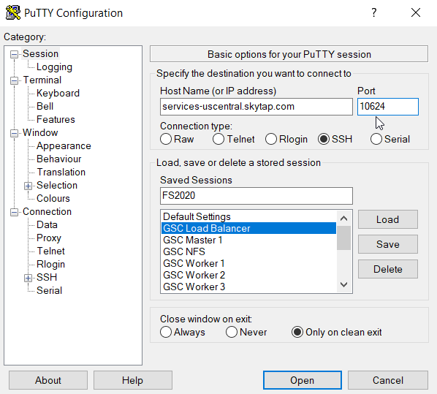
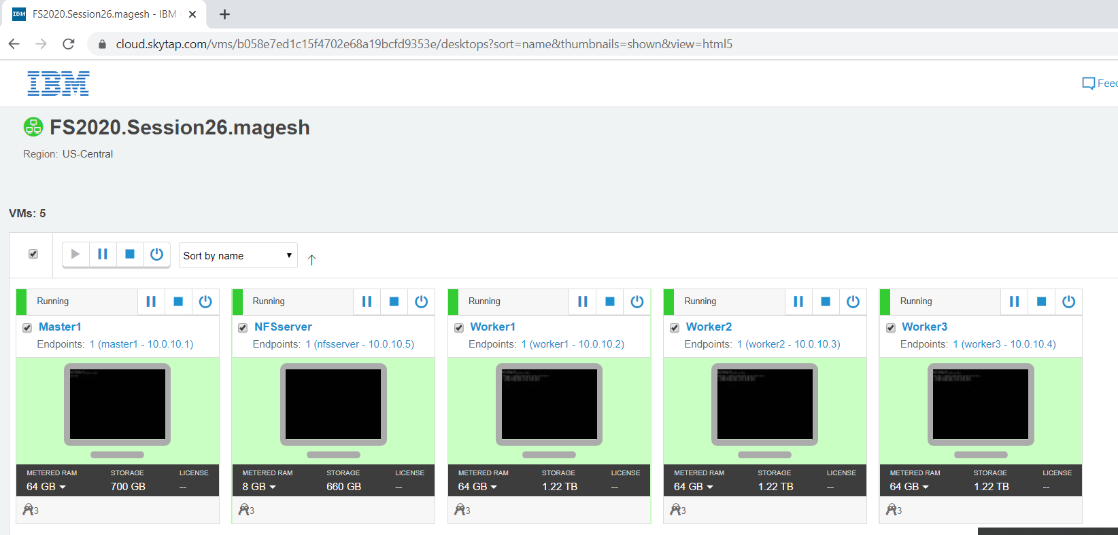
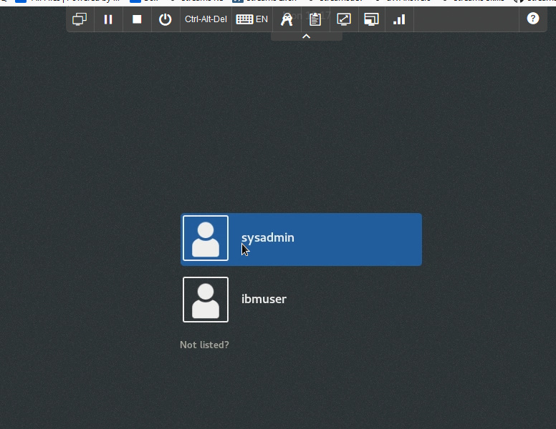
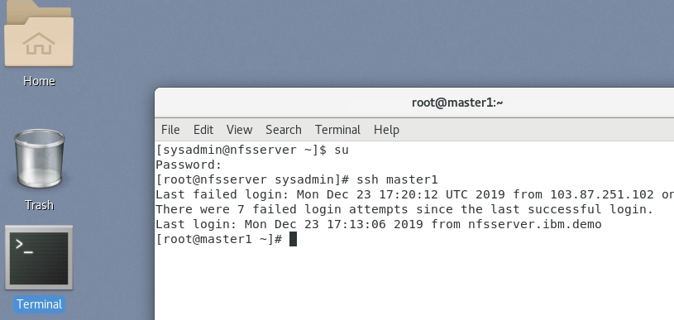
Connect to your Cluster
Connect to your “master1” node over ssh
ssh root@services-uscentral.skytap.com -p {yourportnumber}
Log in as root / IBMDem0s!
OR
From the browser click on your shared portal link (A)
Click on the NFSServer node and it will open in the browser
Log on as sysadmin/IBMDem0s! (B)
su to root/IBMDem0s! (C)
ssh to master1
A
C
B
Notes:
Access via Brower based RTP or SSH (Preferred)
Run Installation from master node
Login: root Password: IBMDem0s! (zero)
Browser based Remote desktop
Use Master Node for Installation
Cheatsheet to be downloaded from box – copy on the Master Node Desktop
Use Browser on NFS Server for accessing cluster
Copy / paste between laptop and skytap via emulator clipboard
Remote access via SSH
terminal window (mac)
Putty (Windows)
File Transfer via Filezilla (SFTP)

Slide 14
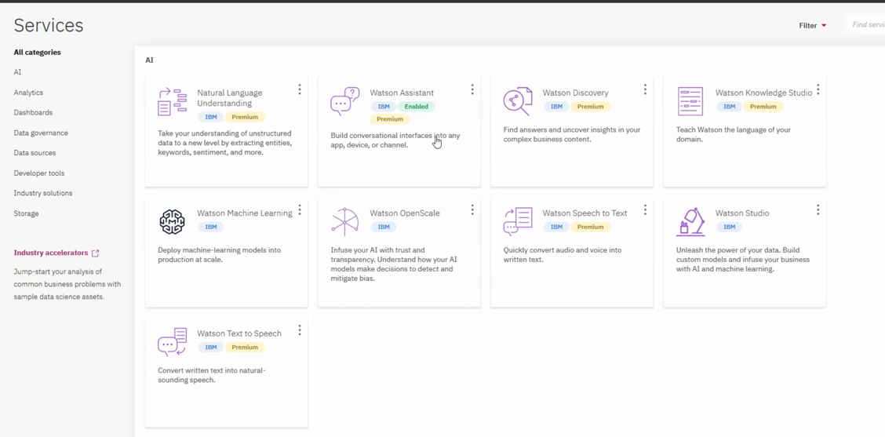
Log into your Cluster
Login to OpenShift & Docker
oc login nfsserver.ibm.demo:8443 -u ocadmin -p ocadmin
docker login -u $(oc whoami) -p $(oc whoami -t ) docker-registry.default.svc:5000
Login CP4D Admin page from a browser (using your custom skytap route) (admin/password)
https://services-uscentral.skytap.com:{youradminportnumber}/zen/#/addons
Notes:
CPD admin page – notice no services show Enabled in green yet like WA example above

Slide 15
Install Instructions
http://ibm.biz/faststartinstallwatson
Download Faststart Cheatsheet from box – either Assistant 1.4 or Discovery 2.11
Edit Cheatsheet with a text editor
Find and rename `sshport` and `adminport`for your install.
Download testing files to your laptop:
wa-api-test.sh, wds-api-test.sh, FAQ.docx
Preconfigured Settings | Description | Value
`cp4d-clustername` | Your cluster name, typically the load balancer FQDN | nfsserver.ibm.demo
`release-name` | What you are calling your release | wd21 {for Discovery} wa14 {for Assistant}
`cp4d-namespace` | Where CP4D was installed | zen
Notes:
Ask who in class is installing wd or wa and add to board
Demo practice wiki and location of all cheatsheets
Faststart cheatsheet has been slightly modified to include preconfiguration done for lab environments
Go to DAELL Practice Wiki -- www.ibm.biz/watsoncp4d
Go to Service Page – ie Watson Assistant
Locate link to Cheat Sheet under “Installation Instructions – Current Release”
Download Cheatsheet from Box (do not use from box, commands lose proper formatting)
Release names cannot exceed 13 characters, no caps, no special characters recommended

Slide 16
Self Guided Lab
Follow the steps in the Cheatsheet to:
Verify Prereqs
Install the Watson Service (either Assistant or Discovery)
Provision the Instance
Verify the Deployment
Access the Service via tooling & api commands
Collect Documentation for your Install
Install Watson from the Master Node
Copy / paste commands from cheatsheet
Do not include surrounding ` ` marks
Debugging to be covered in the next session
EDA21T531BH_Problem Solving & Troubleshooting Watson on Cloud Pak for Data
Notes:
Walk thru how to use cheatsheet

Slide 17
Watch the Deployment in a Second Terminal Window
ssh root@services-uscentral.skytap.com -p {sshport} password=IBMDem0s! (zero, not o)
Assistant: watch kubectl get job,pod,pv --namespace zen -l release=wa14
Discovery: watch kubectl get job,pod,pv --namespace zen -l release=wd21
You are looking for all of the jobs to be in Successful=1 & Pods to be Completed or Running status
**Discovery jobs and pods won’t show in watch until you see `Installing Watson Discovery` (after Loading docker image(s)
INFO [2020-02-04 19:33:13 UTC] Waiting on 1 Docker image(s) to finish pushing
INFO [2020-02-04 19:33:13 UTC] All done!
INFO [2020-02-04 19:33:13 UTC] Installing Watson Discovery
**Pods may take time to spin up after helm deployment completes.

Slide 18
Backup - Installing the WD Language Pack
Requirements: Discovery must be installed and running & must use same release name
#Download language pack & transfer to master node
**already done for you**
mkdir /ibm/wds-lang
tar xJf ibmwatsondiscoverypack1-prod2.1.1.tar.xz -C /ibm/wds-lang
#Change into deploy directory
cd /ibm/wds-lang/deploy
#To Install
./deploy.sh -d /ibm/wds-lang/ibm-watson-discovery-pack1 -r docker-registry.default.svc:5000/zen -R docker-registry.default.svc:5000/zen -e wd21
Notes:
Can ingest non-English docs without language pack but no enrichments
Entity is automatically enabled for an Information Retrieval project. So, without the language pack, IR project cannot process non-English documents.
Users who like to process non-English documents need to install the language pack anyway.

Slide 19
Backup - WD Language Pack
########################################################################
Module: ibm-watson-discovery-pack1
Release Name: wd21
Namespace: zen
Tiller Namespace: zen
Docker Registry Push Prefix: docker-registry.default.svc:5000/zen
Docker Registry Pull Prefix: docker-registry.default.svc:5000/zen
########################################################################
INFO [2020-02-05 22:22:48 UTC] Ready to upgrade Watson Discovery?
Enter y[es] to continue, or n[o] to cancel the installation: yes
INFO [2020-02-05 22:22:49 UTC] Loading docker image(s) from '/ibm/wds-lang/ibm-watson-discovery-pack1/images/images.tar'
Loaded image: watson-nlp-models:0.0.12-5389f98
The push refers to a repository [docker-registry.default.svc:5000/zen/watson-nlp-models]
Waiting on 1 Docker image(s) to finish pushing
INFO [2020-02-05 22:27:18 UTC] Waiting on 1 Docker image(s) to finish pushing
INFO [2020-02-05 22:27:18 UTC] All done!
INFO [2020-02-05 22:27:18 UTC] Patching Watson Discovery to enable NLP for additional languages
statefulset.apps/disco211-watson-discovery-hdp-worker patched
Warning – takes 30 -40 minutes for each hdp-worker pods to restart with new NLU capabilities
Notes:
Can ingest non-English docs without language pack but no enrichments
Entity is automatically enabled for an Information Retrieval project. So, without the language pack, IR project cannot process non-English documents.
Users who like to process non-English documents need to install the language pack anyway.

Slide 20
Backup – Installing WD with Content Intelligence
Requirements: Customer must purchase Content Intelligence license in addition to Discovery License
#Download Content Intelligence PPA & transfer to master node
mkdir /ibm/wds_ci
tar -xJf <ci-service-ppa-archive> -C /ibm/wds_ci
mv ci-override.yaml /ibm/ibm-watson-discovery-ppa/deploy
#Change into deploy directory
cd /ibm/ibm-watson-discovery-ppa/deploy
To install
export DOCKER_REGISTRY_PREFIX=docker-registry.default.svc:5000/zen
./deploy.sh -d /ibm/ibm-watson-discovery-ppa/ibm-watson-discovery -c {cp4dcluster} -C zen -r $DOCKER_REGISTRY_PREFIX -R $DOCKER_REGISTRY_PREFIX -s portworx-nonshared-gp -S portworx-shared-gp -O ci-override.yaml -e {wds-release-name}
Notes:
Once installed, you will have additional enrichments available: Contracts, Purchase Orders and Invoices

Slide 21
References
DAELL CP4D Practice Wiki: www.ibm.biz/watsoncp4d
CP4D and Watson Release info: www.ibm.biz/cp4drelease
Cloud Pak for Data Install Assets: https://ibm.ent.box.com/v/cp4d-install
CP4D Licensing: https://apps.na.collabserv.com/wikis/home?lang=en-us#!/wiki/Wd855b33ea663_4b57_a7c7_f5e8e37c2716/page/Cloud%20Pak%20for%20Data%20%26%20Watson%20Licensing
Portworx Reference: https://apps.na.collabserv.com/wikis/home?lang=en-us#!/wiki/Wd855b33ea663_4b57_a7c7_f5e8e37c2716/page/Portworx%20Reference
CP4D Product Home: https://www.ibm.com/support/producthub/icpdata/docs/content/SSQNUZ_current/cpd/overview/overview.html
Content Intelligence https://apps.na.collabserv.com/blogs/152f58a2-3bb3-4992-86a7-c56ad4bbd21c/entry/Introducing_Watson_Discovery_Content_Intelligence?lang=en_us
Faststart replays on Seismic: https://ibm.seismic.com/Link/Content/DChXM-Dl2TbkO4gQPCGpez_g

Slide 22
Cloud Pak for Data 2.5 and OpenShift 3.11 Deployment Checklist
Software Download
RH OpenShift Subscription
RedHat Satellite Repository setup is needed for AIRGAP
Local Docker Registry for AIRGAP
Cloud Pak for Data Download
Transfer Cloud Pak Installers to Bastion Host
Minimum Hardware Requirements
Master Node (x1 or x3 for high availability)
OS: RHEL 7.6
CPU/RAM: 8 CPU, 32 GB RAM
Disk: 300 GB (100 GB Root, 200GB Docker)
Security Group: Allow all traffic between nodes
Private IP
Worker Node (3)
OS: RHEL 7.6
CPU/RAM: 16 CPU, 64 GB RAM
AVX2 Support (Watson Assistant, Discovery, NLU)
Disk (100GB Root, 200GB Docker)
SE Linux enforce
Security Group: Allow all traffic between nodes
Private IP
Load Balancer/HAPROXY Node (only when using high availability. Not needed for single master node installation.)
OS: RHEL 7.6
CPU/RAM: 4 CPU, 8 GB RAM
Disk: 100 GB
Public IP
Security Group: Allow all traffic between nodes
Bastion Host
OS: RHEL 7.6
CPU/RAM: 4 CPU, 8 GB RAM
Disk: 100 Root; 200 Docker ; 500 GB local repo/registry
Public IP
Security Group: Allow all traffic between nodes
storage
NFS Storage
1 TB storage Cloud Pak for data persistence storage
Portworx Storage (required for Watson Extensions)
Minimum 1 TB of raw, unformatted disk on every worker node designated for Storage (Raw disk must have the same device name on all worker node
Requires CRI-O container service (latest version 1.11.16 or later) on all nodes (master, infra & worker nodes)
Requires Podman on all nodes in the cluster (master, infra & worker nodes)
Networking
DNS
Public URL
DNS wild card entry for application routing
ex: (*.apps.cloudpak.example.com. 300 IN A 192.168.133.2)
443, 8443 ports opened for external to Master/Load balancer
All nodes have static IP
Overlay network that used by OpenShift(cidr)
All TCP/UDP traffics allowed between nodes
All hostname should be lower case
All Nodes in the same subnet with 1GB or higher network
Cloud pak for data
OpenShift User (ocadmin) with cluster admin role
$ oc adm policy add-cluster-role-to-user cluster-admin ocadmin
Client machine or Bastion Host connecting to Cluster
Cloud Pak for Data Installer downloaded
Login to cluster
$ oc login OpenShift_URL:port
Cluster Registry Access
$ Docker login <docker registry url> -u <user> -p <password>

Slide 23
Please give us your feedback – Access the survey link at the bottom of the
session details in the mobile app.
Jennifer Wales
Offering Manager, Data and AI Expert Labs
jennifer_wales@us.ibm.com
Brandon Swink
Analytics and AI Architect, North America
swink@us.ibm.com

Slide 24
Thank you

